Slide 1
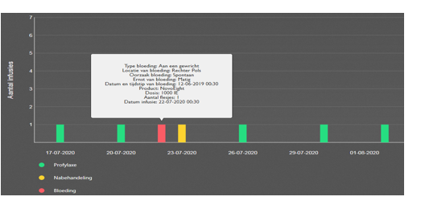
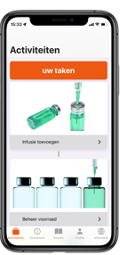
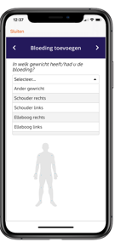
THE HEMONED REGISTRY FOR PERSONS WITH
BLEEDING DISORDERS IN THE NETHERLANDS:
AN UPDATE OF THE DUTCH EXPERIENCE
Elisabeth M. Taal¹, Mariëtte H. Driessens², Marlène Beijlevelt-van der Zande³, Paul L. den Exter¹, Kathelijn Fischer⁴,
Geertje Goedhart¹, Marieke J. Kruip⁵, Britta A. Laros-van Gorkom⁶, Stephan L. Meijer², Marjet A. Stein-Wit⁷,
Caroline M. van Veen¹, Karina Meijer ⁸, Samantha C. Gouw ³
¹Department of Thrombosis and Hemostasis, Leiden University Medical Center, Leiden, ²Netherlands Hemophilia Patient
Society, Nijkerk, ³Pediatric Hematology, Emma Children's Hospital, Amsterdam University Medical Centers, University of
Amsterdam, Amsterdam, ⁴Van Creveld Clinic, University Medical Center Utrecht, Utrecht, ⁵Department of Hematology,
Erasmus MC, University Medical Center Rotterdam, Rotterdam, ⁶Department of Hematology, Radboud University Medical
Center, Nijmegen, ⁷Department of Pediatric Hematology, Beatrix Children's Hospital, University Medical Center Groningen,
Groningen, ⁸Department of Hematology, University Medical Center Groningen, Groningen, The Netherlands
PO 183
INTRODUCTION
RESULTS
Hemophilia A
The HemoNED registry is a joint initiative of the national hemophilia organizations of patients, clinicians and nurses
All parties are represented in the Steering committee
HemoNED continuously registers data on:
Diagnosis
Treatment
Adverse events (National & EUHASS)
Outcomes
Table 1 Diagnosis of patients included in HemoNED (July 2022)
.
Hemophilia A
Diagnosis | # Patients
Hemophilia A | 1393
Hemophilia B | 199
Von Willebrand Disease | 619
Carrier | 136
Acquired bleeding disorder | 23
Other bleeding disorder | 163
Total | 2533
Hemophilia B
Figure 2. Hemophilia type and severity of patients included in
HemoNED
AIM
The HemoNED registry aims to improve the quality of care for people with hemophilia and associated disorders
METHOD
Patients are registered by their HTC after written informed consent
Patients register their treatment and details on bleeds in a digital treatment diary (Figure 1)
Treatment centers can view and add data in a dashboard (Figure 4)
Figure 3. The use of emicizumab or factor VIII products in patients with hemophilia A on prophylactic treatment (N=607)
Figure 4. The dashboard to monitor the patients infusions, bleeds and aftercare
CONCLUSIONS
FUTURE PLANS
Included in HemoNED:
Almost 75% of all hemophilia patients
95% of patients with severe hemophilia
44% of all severe patients use the app
Efforts are made to:
Include more people with other bleeding disorders
Keep the data up to date
Assure data quality
Optimize the use of the digital treatment diary and dashboard by extra support
own text.
Collect data from patients who underwent gene therapy
Intention to share the data with the WFH Gene Therapy Registry
Decrease burden of registration and improve data quality by:
Data standardization of bleeds & treatment
Automatic data extraction from electronic hospital records
Just highlight this text and replace with your own text.
Figure 1. The digital treatment diary (Mobile app)
ACKNOWLEDGEMENT
CONTACT INFORMATION
In 2022 HemoNED received a grant/research support from:
CSL Behring, Novo Nordisk, Octapharma, Pfizer, Roche, Sobi, Takeda
National Health Care Institute (Zorginstituut Nederland)
www.hemoned.nl/en/
info@hemoned.nl
Project coordinator
Ms. Caroline van Veen

